Slide 1

University College Cork
Generating Images Using a Deep Convolutional GAN
Kai

Slide 2

01
Introduction
02
Historical Models
Overview
03
Theoretical Background
04
Results
05
Discussion

Slide 3
University College Cork
1 Introduction
Kai

Slide 4
Introduction
01
What is GAN?
Generative Adversarial Networks (GAN) were introduced by Ian Goodfellow in 2014.
Why GAN for Image Generation?
• GAN is widely used in image generation because it can create high-quality, realistic images.
• it is used in various fields like art creation, face generation, medical imaging, and even style transfer.
Challenges with GAN
GAN is notoriously difficult to train due to issues like mode collapse, vanishing gradients, and instability during adversarial training.
Objective of the Study
• Explore how to improve the performance of GAN in image generation tasks.
• Investigate methods to stabilize GAN training and enhance image quality.

Slide 5
University College Cork
2 Historical
Models
Kai

Slide 6
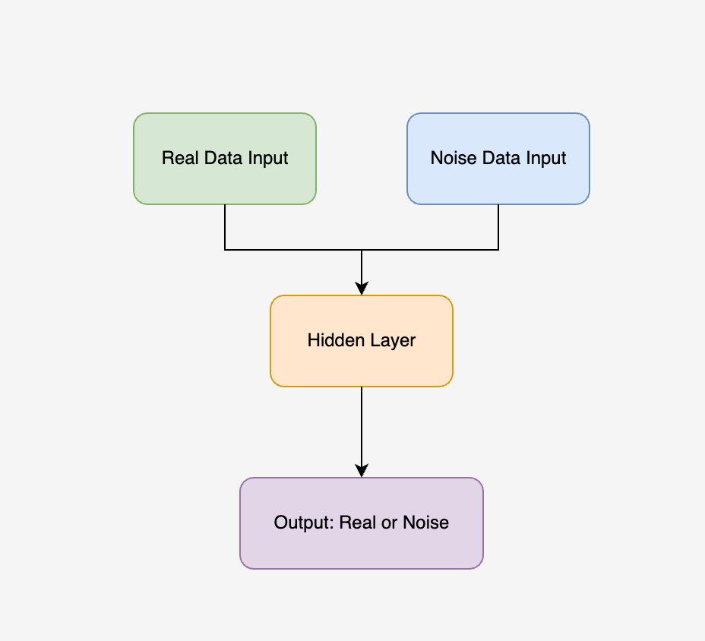
02
Noise Contrastive Estimation
What is the NCE?:
Introduced in 2010 by Gutmann is a statistical method that simplifies learning by contrasting real data with noise.
Architecture:
• Two data inputs: Real data and noise samples.
• The model classifies between real and noisy data using binary classification.
Applications:
Widely used in density estimation and language modelling, laying the groundwork for image and text generation.

Slide 7
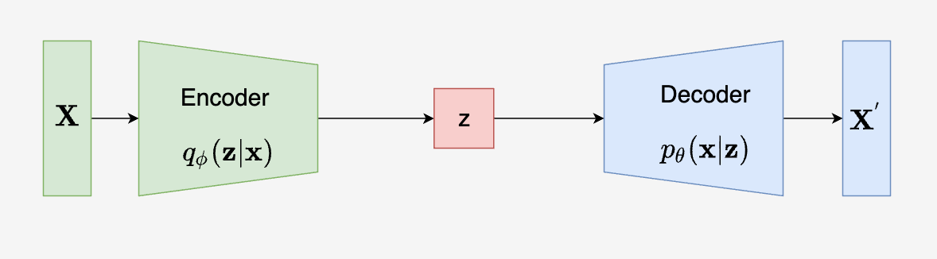
03
Variational Autoencoder
What is the VAE?:
Introduced in 2013 by Kingma, VAE is a generative model that encodes input data into a latent space and reconstructs it by minimizing the reconstruction loss.
Architecture:
• Encoder: Compresses the input data into a smaller form (latent space).
• Decoder: Rebuilds the data from the compressed form.
Applications:
VAEs are used for image generation, data compression, and anomaly detection.

Slide 8
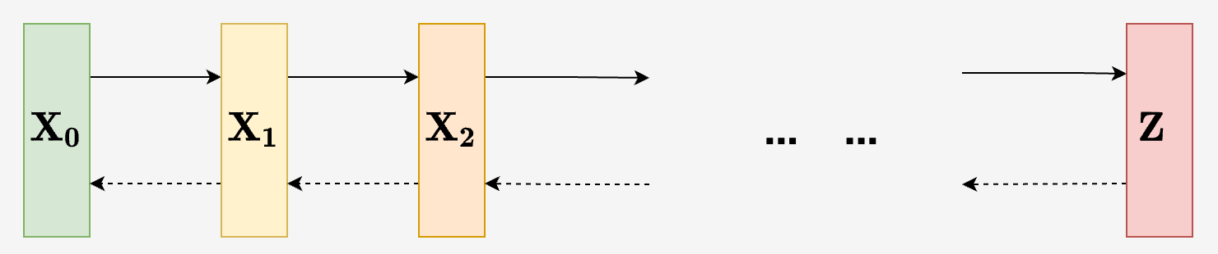
Diffusion Model
04
What is the Diffusion Model?:
Introduced in 2020 by Jonathan, these models progressively add noise to the data and learn to reverse this process to generate high-quality outputs.
Architecture:
• Forward Process: Gradually adds Gaussian noise to the data.
• Reverse Process: Reverse the noise addition to reconstruct the original data.
Applications:
Diffusion models are used in image generation, audio synthesis, and medical imaging.

Slide 9
University College Cork
3 Theoretical Background
Kai

Slide 10
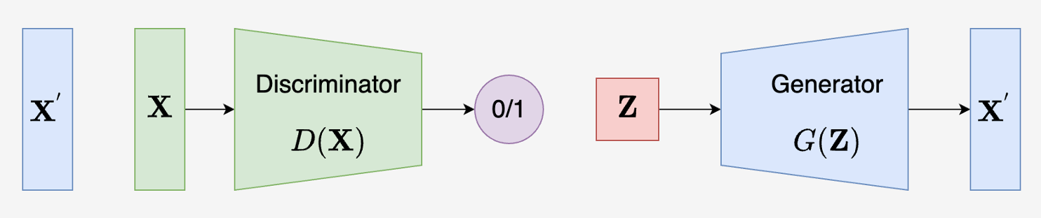
Generative Adversarial Network
05
What is GAN?:
GAN (Generative Adversarial Network) was introduced by Ian Goodfellow in 2014. It consists of two networks—a generator and a discriminator—that compete to improve data generation quality.
Architecture:
• Generator: Creates synthetic data to mimic real data.
• Discriminator: Distinguishes between real and generated data.
Applications:
Widely used in image generation, video synthesis, and style transfer for its ability to produce realistic data.

Slide 11
06
Objective Function of GAN
Objective Function:
• GAN use a minimax game between the generator and the discriminator.
• The generator tries to minimize the difference between real and generated data, while the discriminator tries to maximize it.
Generator’s Goal:
Minimize the probability that the discriminator correctly identifies fake data.
Discriminator’s Goal:
Maximize the probability of correctly distinguishing between real and fake data.

Slide 12
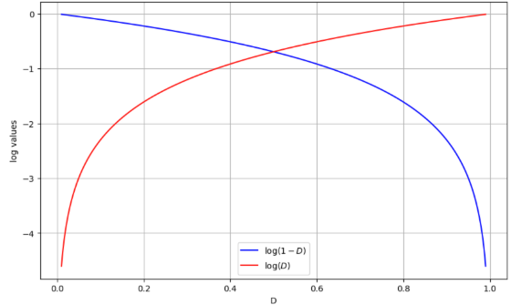
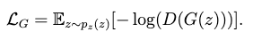
07
Loss Function of GAN
Discriminator’s Loss:
Measures how well the discriminator classifies real and fake data.
Loss function:
Generator’s Loss:
Measures how well the generator fools the discriminator.
Loss function:

Slide 13
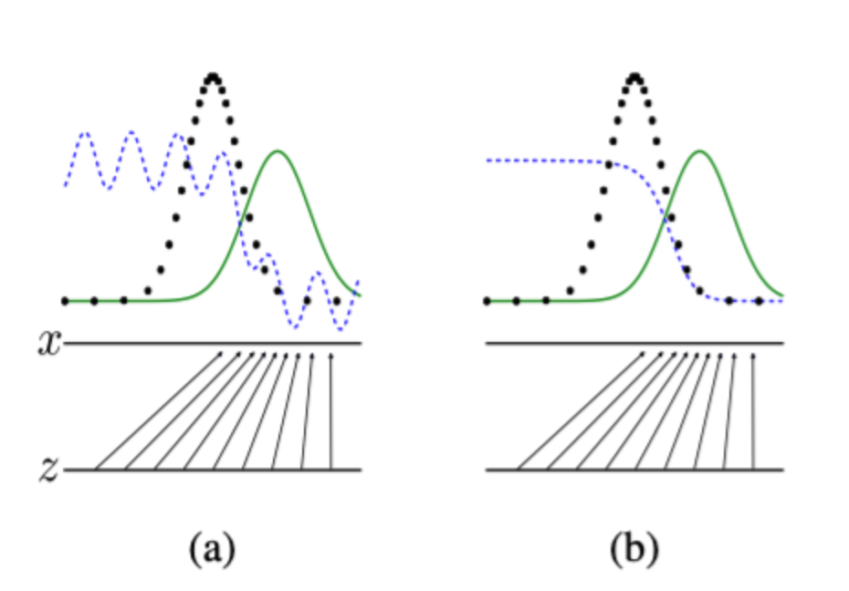
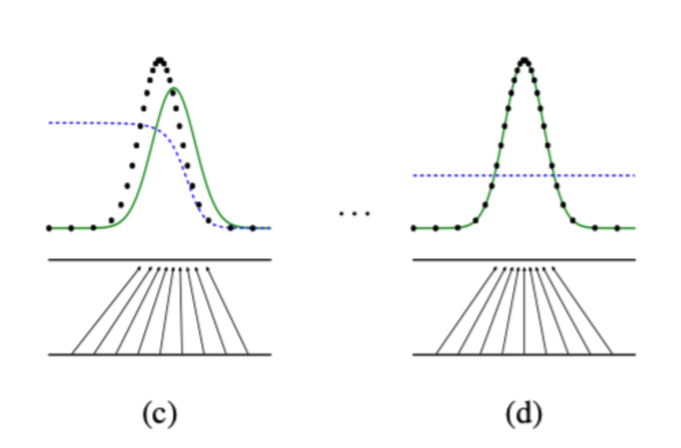
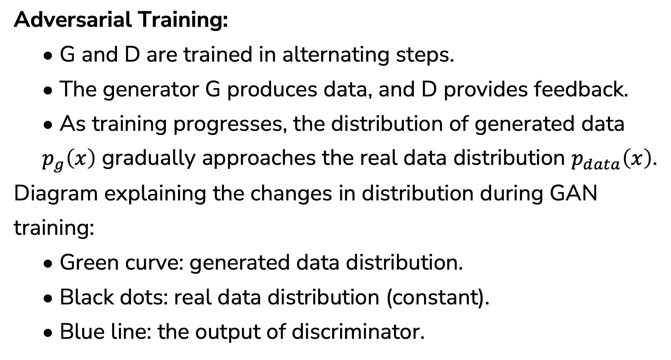
08
Training Process of GAN
Adversarial Training:
• G and D are trained in alternating steps.
• The generator G produces data, and D provides feedback.
• As training progresses, the distribution of generated data $p_{g}\left(x\right)$ gradually approaches the real data distribution $p_{data}\left(x\right)$.
Diagram explaining the changes in distribution during GAN training:
• Green curve: generated data distribution.
• Black dots: real data distribution (constant).
• Blue line: the output of discriminator.

Slide 14
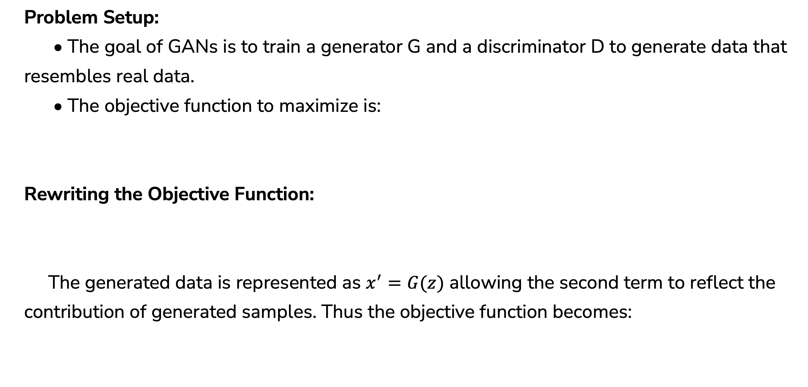
09
Training Process of GAN
Problem Setup:
• The goal of GANs is to train a generator G and a discriminator D to generate data that resembles real data.
• The objective function to maximize is:
Rewriting the Objective Function:
The generated data is represented as $x^{′}=G(z)$ allowing the second term to reflect the contribution of generated samples. Thus the objective function becomes:

Slide 15
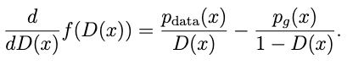
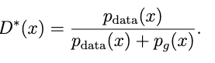
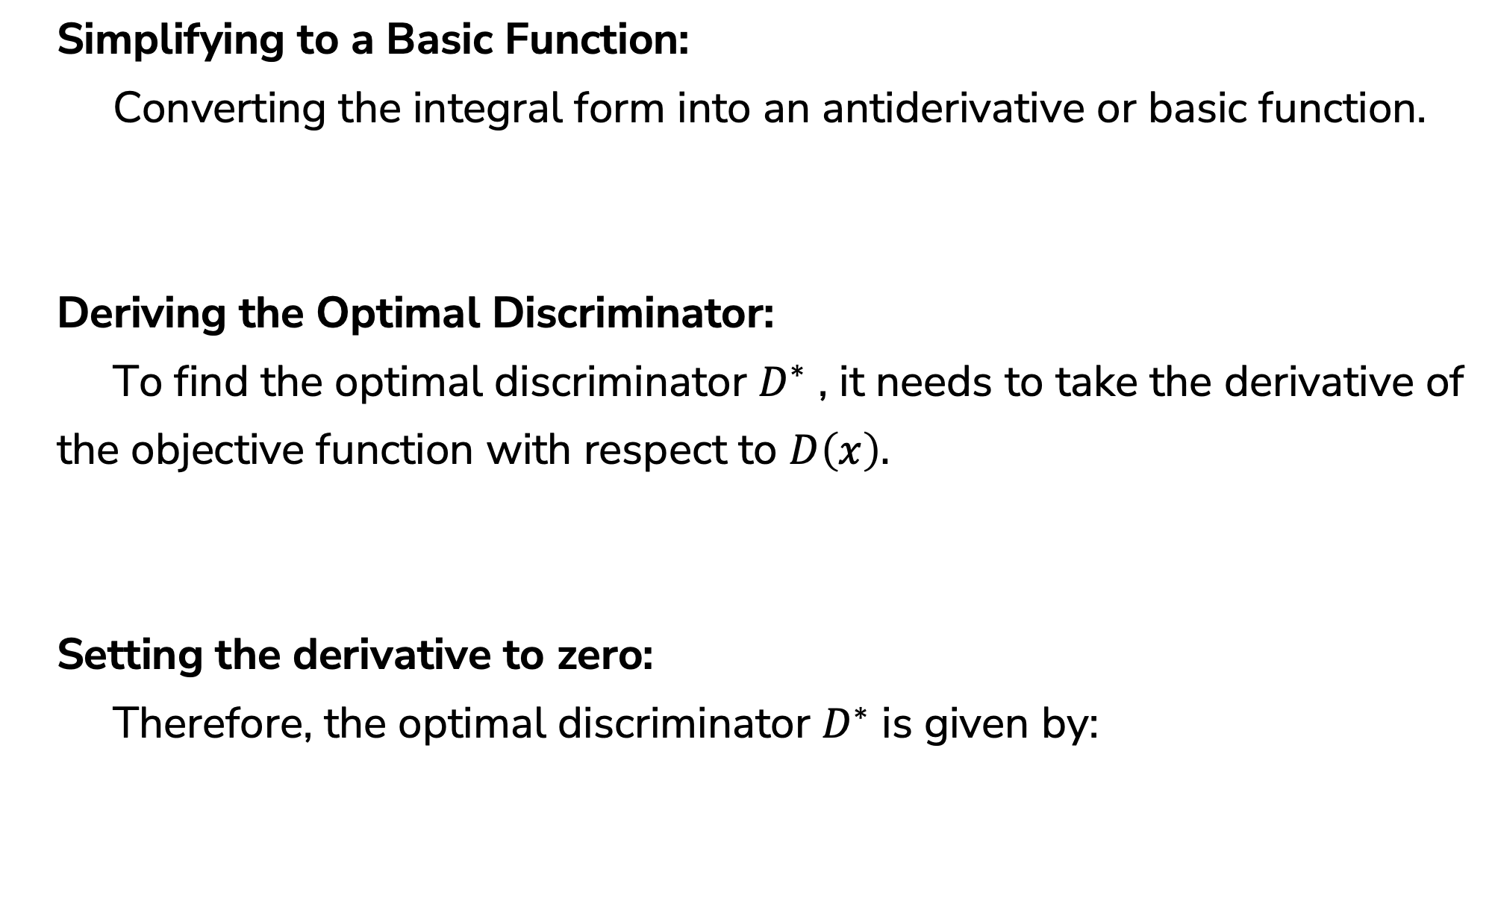
10
Training Process of GAN
Simplifying to a Basic Function:
Converting the integral form into an antiderivative or basic function.
Deriving the Optimal Discriminator:
To find the optimal discriminator $D^{∗}$ , it needs to take the derivative of
the objective function with respect to $D\left(x\right).$
Setting the derivative to zero:
Therefore, the optimal discriminator $D^{∗}$ is given by:

Slide 16
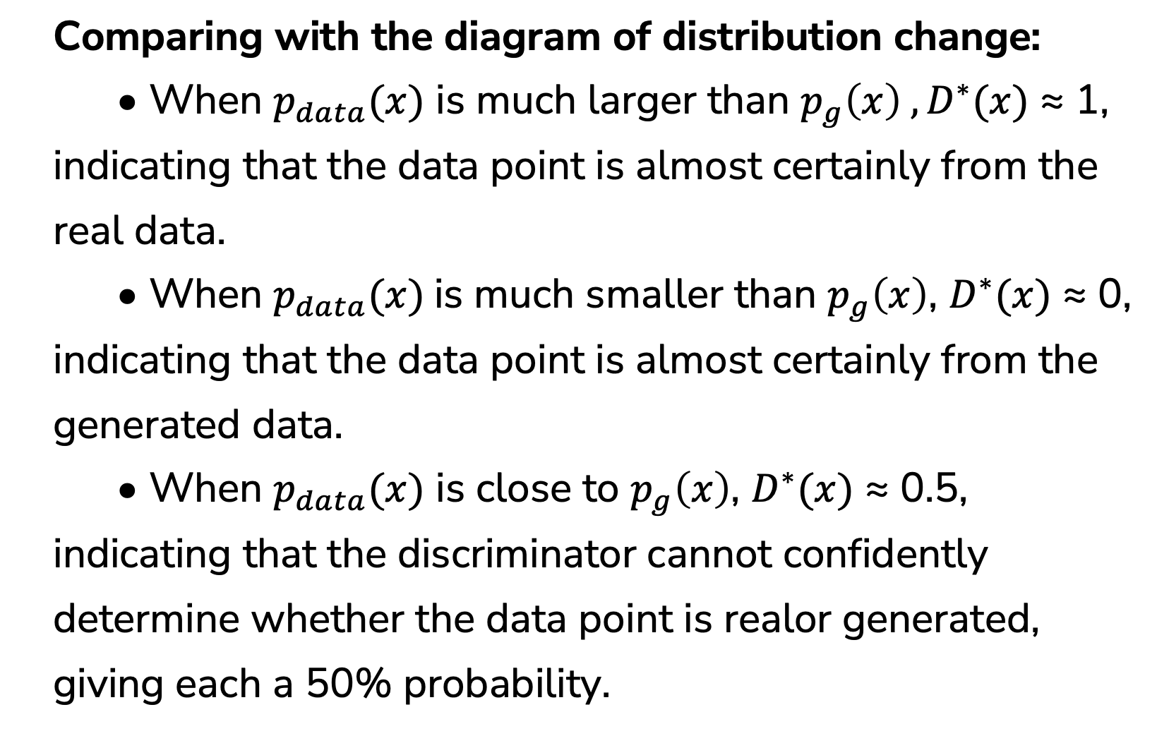
Verifying the Optimal Discriminator
11
Comparing with the diagram of distribution change:
• When $p_{data}(x)$ is much larger than $p_{g}\left(x\right) ,D^{∗}(x)$ ≈ 1, indicating that the data point is almost certainly from the real data.
• When $p_{data}(x)$is much smaller than $p_{g}\left(x\right)$, $D^{∗}(x)$ ≈ 0, indicating that the data point is almost certainly from the generated data.
• When $p_{data}(x)$ is close to $p_{g}\left(x\right)$, $D^{∗}(x)$ ≈ 0.5, indicating that the discriminator cannot confidently determine whether the data point is realor generated, giving each a 50% probability.

Slide 17
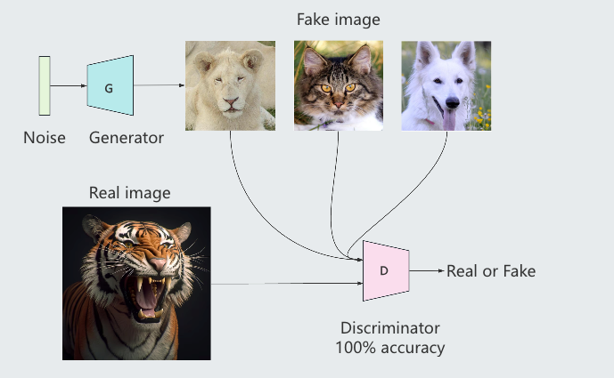
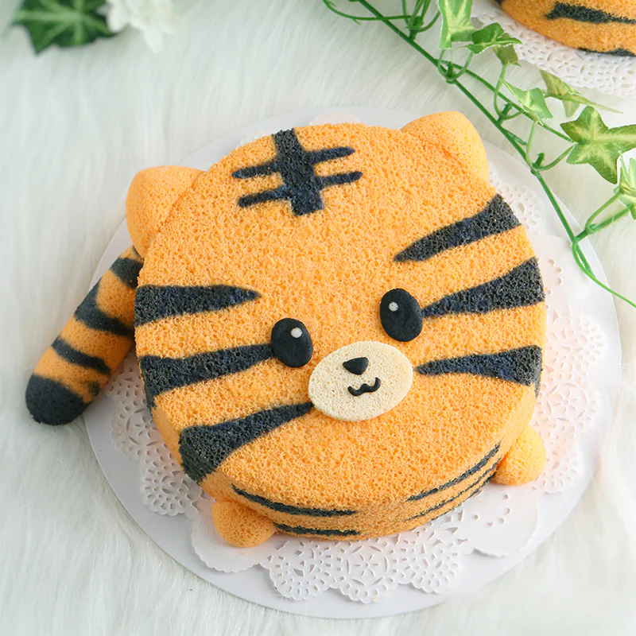
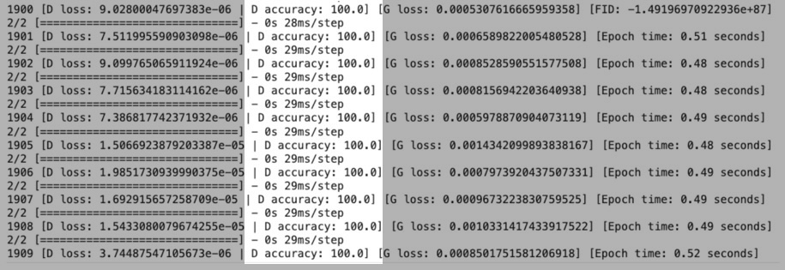
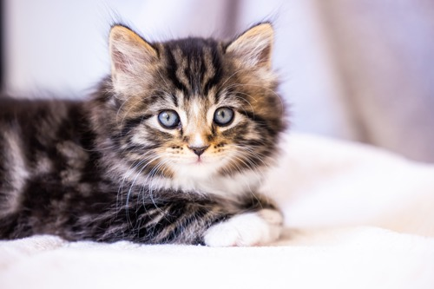
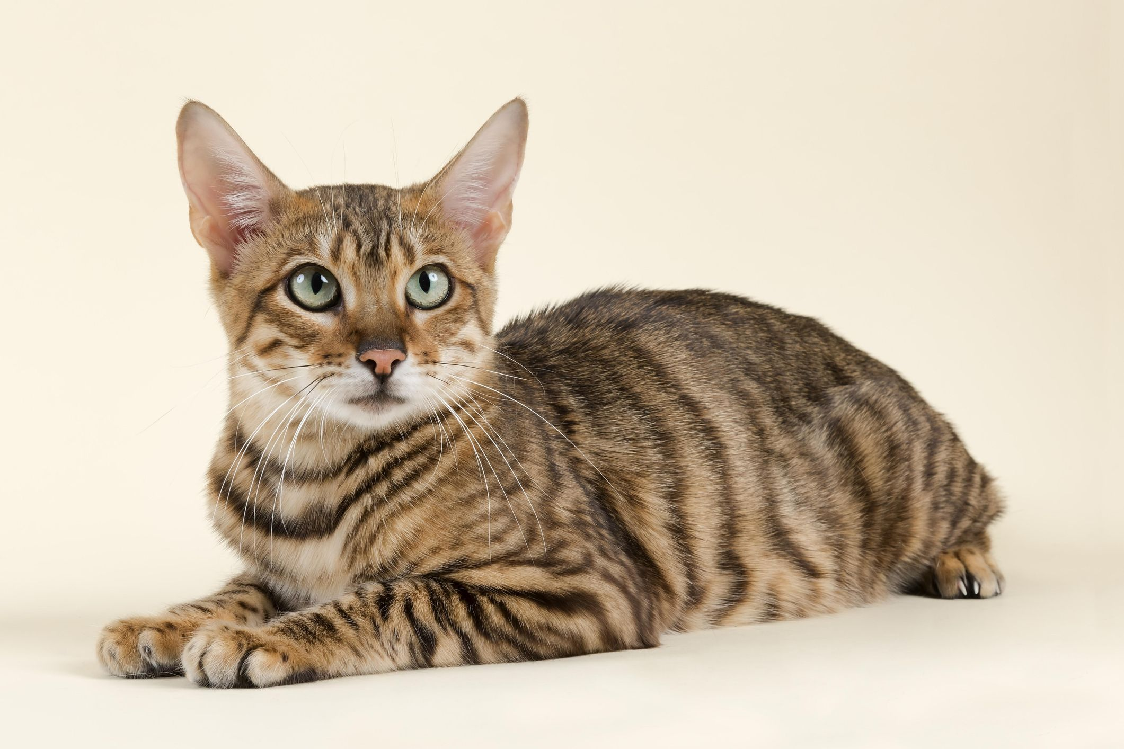
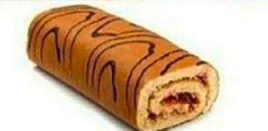
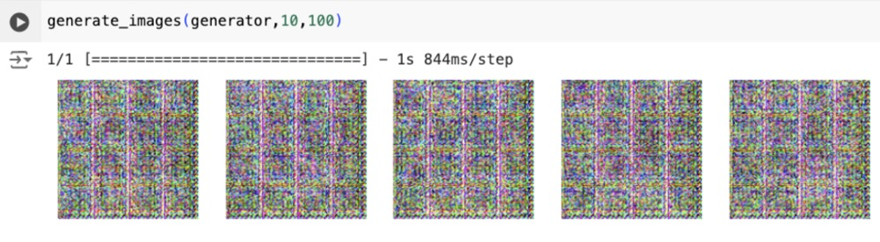
12
Evaluating GAN Performance
• In most machine learning models, accuracy is a key evaluation metric. However, in the case of GAN training, achieving 100% accuracy indicates a problem. It means that the balance between the generator and the discriminator is broken.

Slide 18
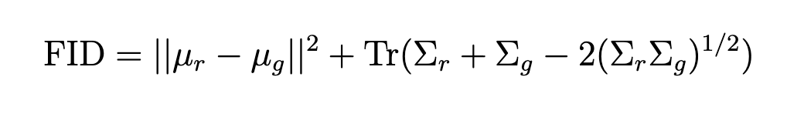
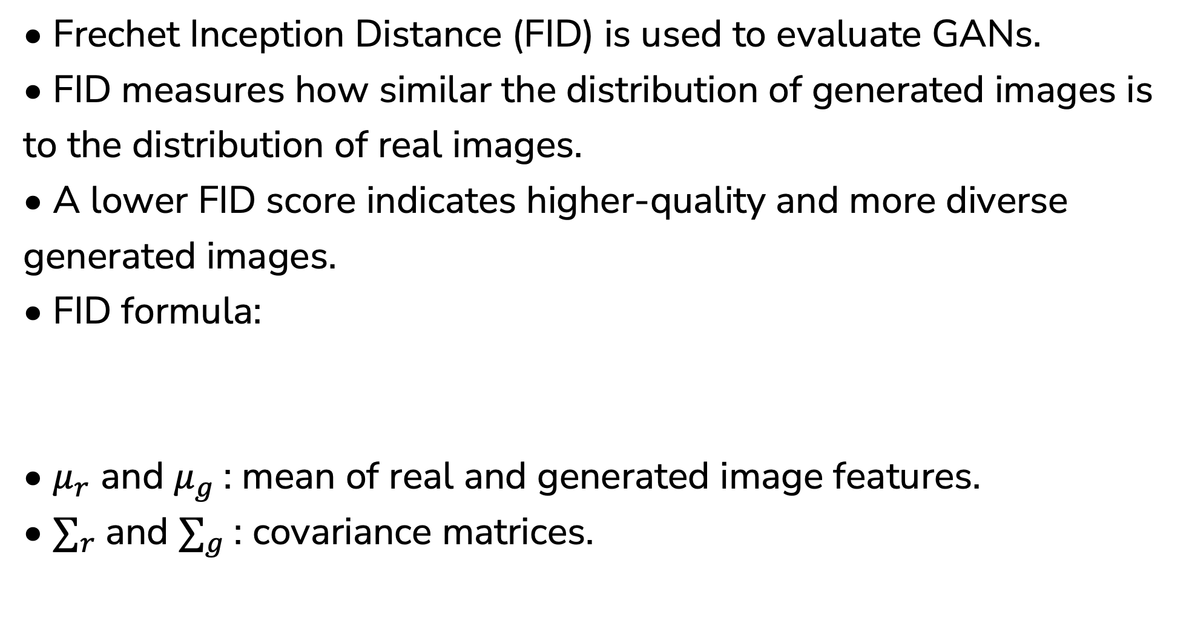
13
Frechet Inception Distance
• Frechet Inception Distance (FID) is used to evaluate GANs.
• FID measures how similar the distribution of generated images is to the distribution of real images.
• A lower FID score indicates higher-quality and more diverse generated images.
• FID formula:
• $μ_{r}$ and $μ_{g}$: mean of real and generated image features.
• $∑_{r}$and $∑_{g}$: covariance matrices.

Slide 19
University College Cork
4 Results
Kai

Slide 20
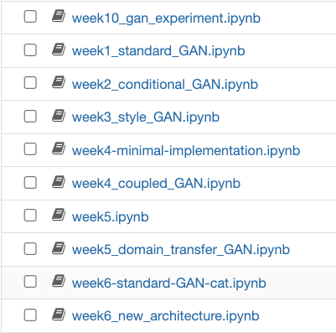
14
Model Select
Reason for Choosing Standard GAN:
• Foundational Model: Standard GAN serves as the base for all other GAN variants.
• Well-documented: Extensive literature available for comparison and reference.
• Training Efficiency: More computationally feasible to implement within hardware constraints.
• Flexibility: Can be adapted to various image generation tasks, providing a solid baseline for comparison with more complex models.

Slide 21
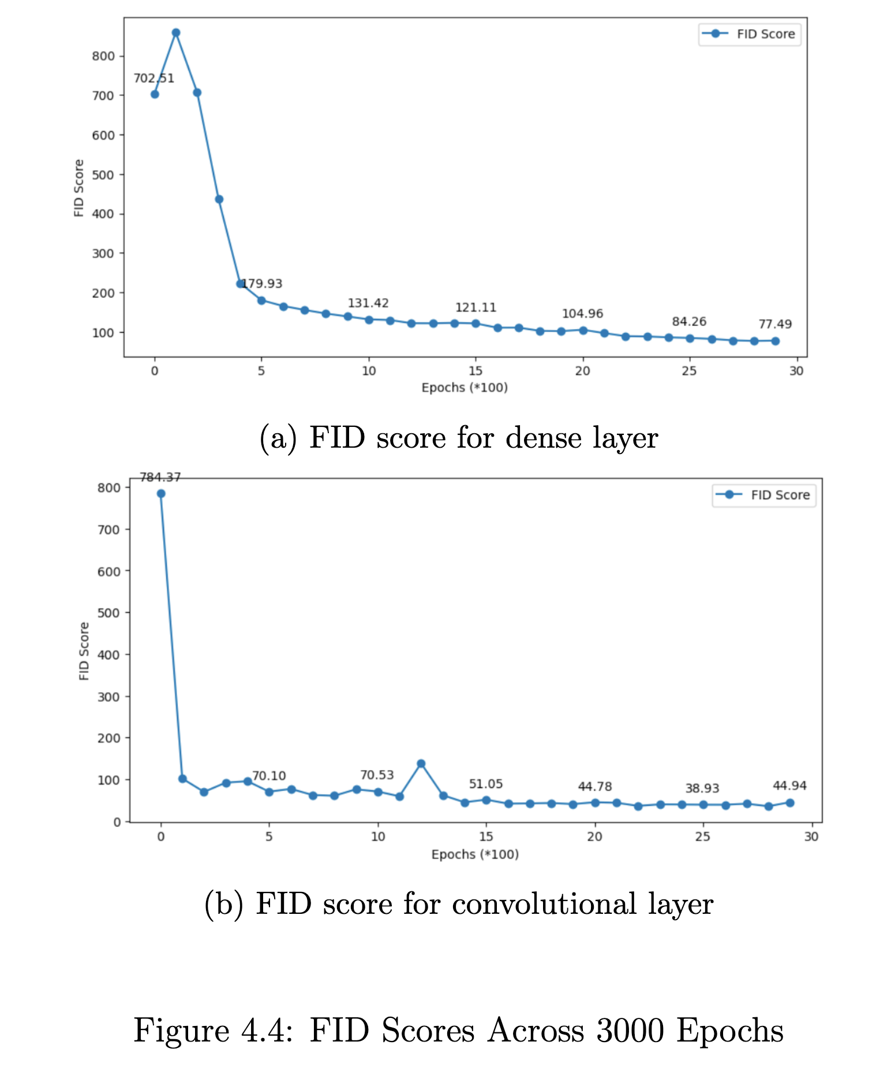
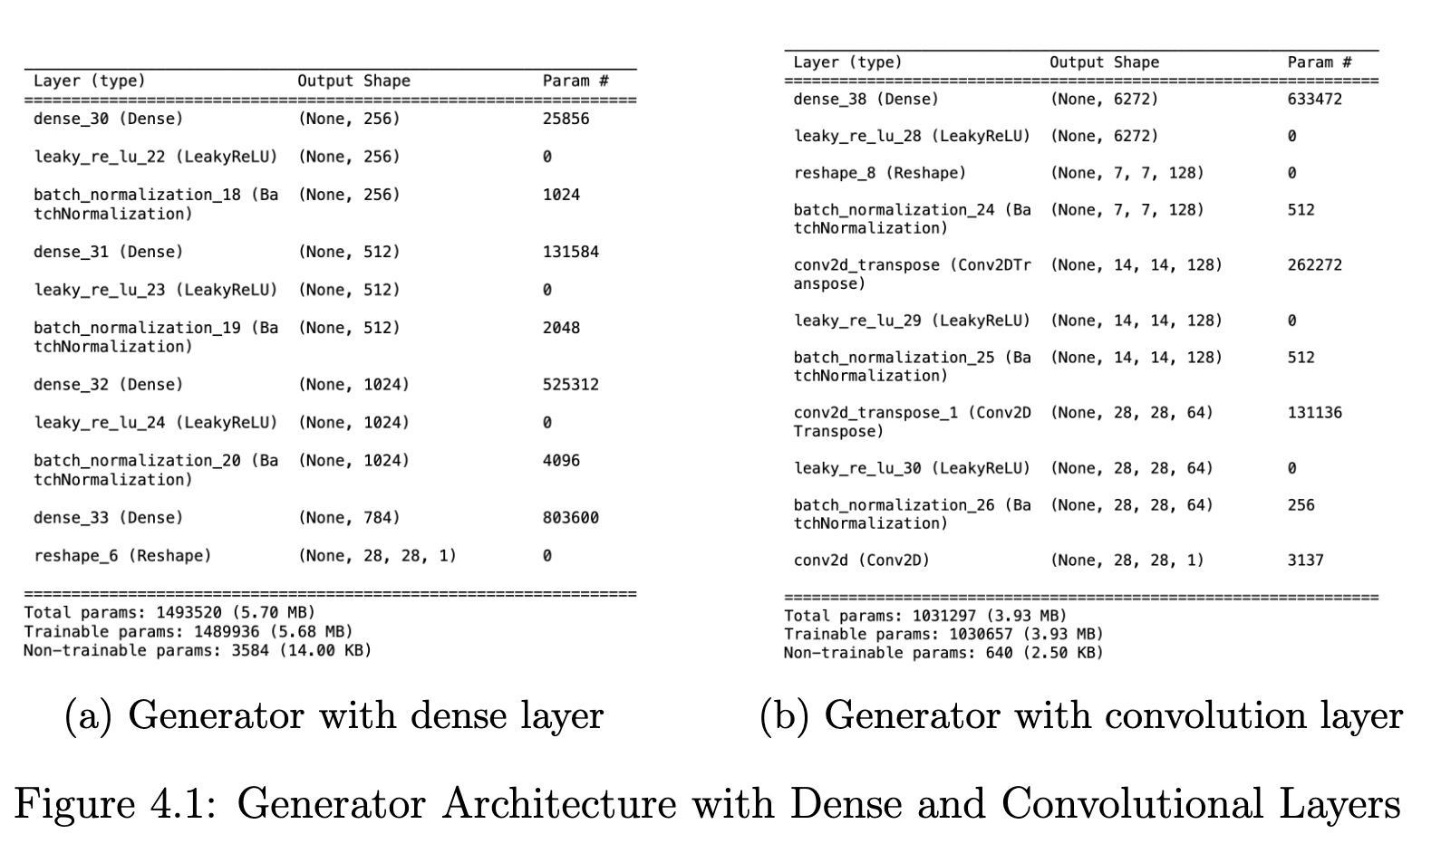
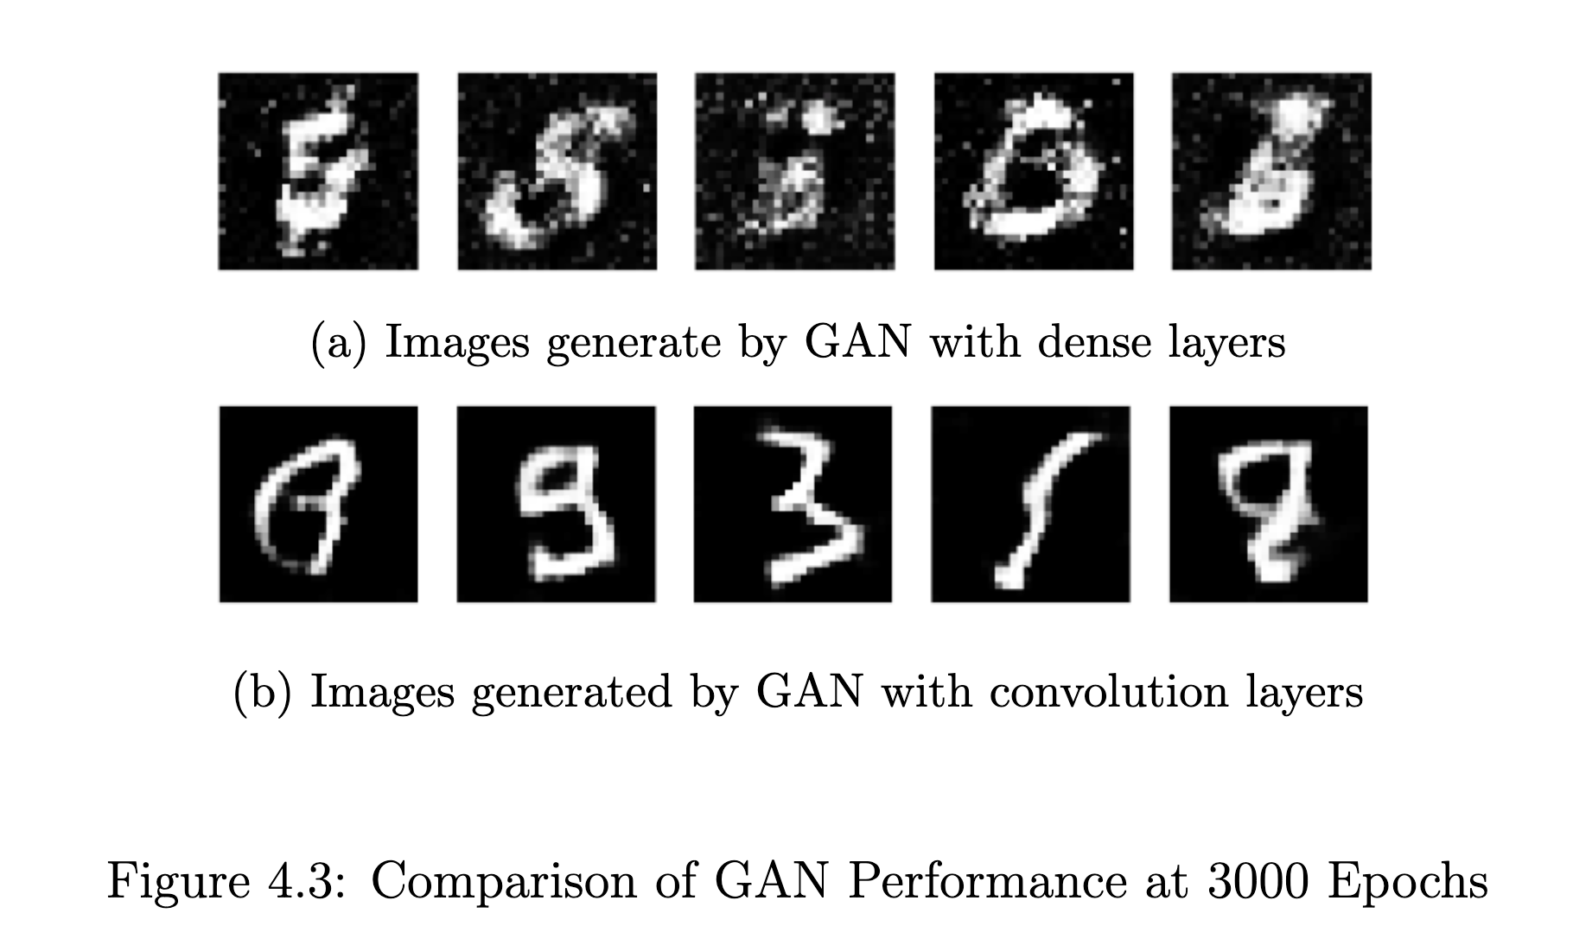
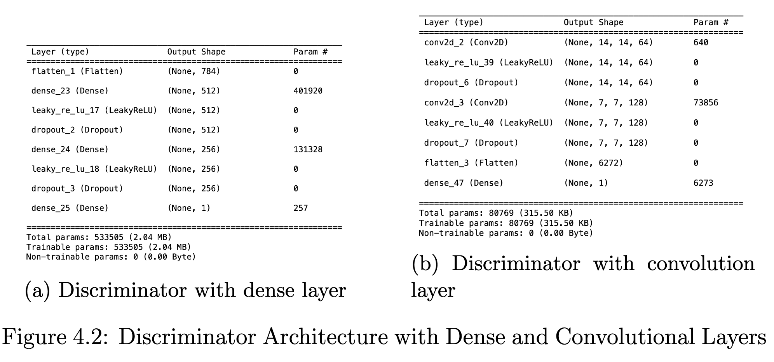
15
Convolutional or Dense
Objective:
• Compare the performance of Convolutional Layers and Dense Layers in the generator and discriminator of a standard GAN.
Key Factors Tested:
• Image quality.
• FID score.
• Training time.
Dataset:
• MNIST Dataset (3000 epochs).

Slide 22
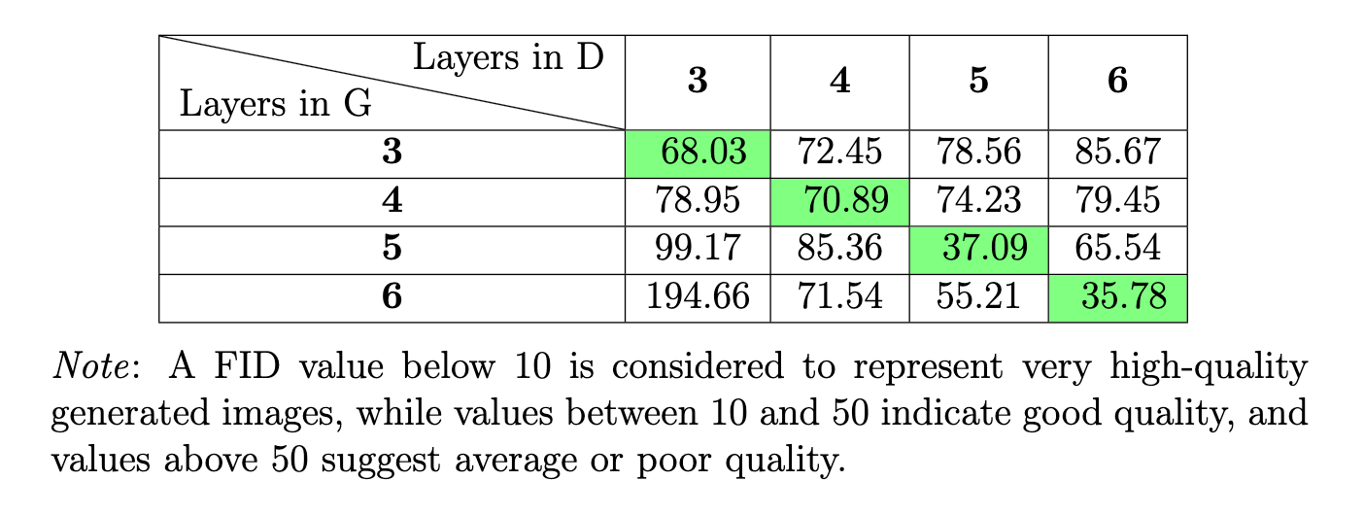
16
Exploring Layer Depth
Key Objective:
• Investigate the impact of increasing convolutional layer depth on GAN performance.
Experiment Setup:
• Base Model: Standard GAN (with convolutional layers).
• Layer Variations: 3, 4, 5, and 6 layers in both generator and discriminator.
• Key Metric: Frechet Inception Distance (FID) to evaluate image quality.
Results:
• Increasing depth in only the generator or discriminator leads to worse performance.
• Increasing depth in both networks simultaneously results in better performance.

Slide 23
17
Impact of Data Augmentation
Objective:
• Evaluate the impact of data augmentation techniques in GAN.
Techniques Tested:
• Rotation: Rotating images by a 10 degree.
• Shifting: Vertical and horizontal shift 0.1.
• Flipping: horizontal flips.
Results:
Without Data Augmentation model performs best.
After Adjustments:
• Removing certain techniques (e.g., flipping, rotation).

Slide 24
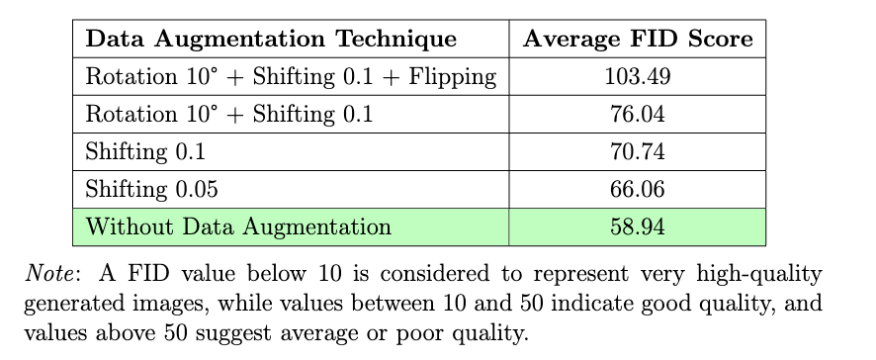
18
Impact of Data Augmentation
Results
Assumption:
Data augmentation introduced noise, disturbing the real data distribution.

Slide 25
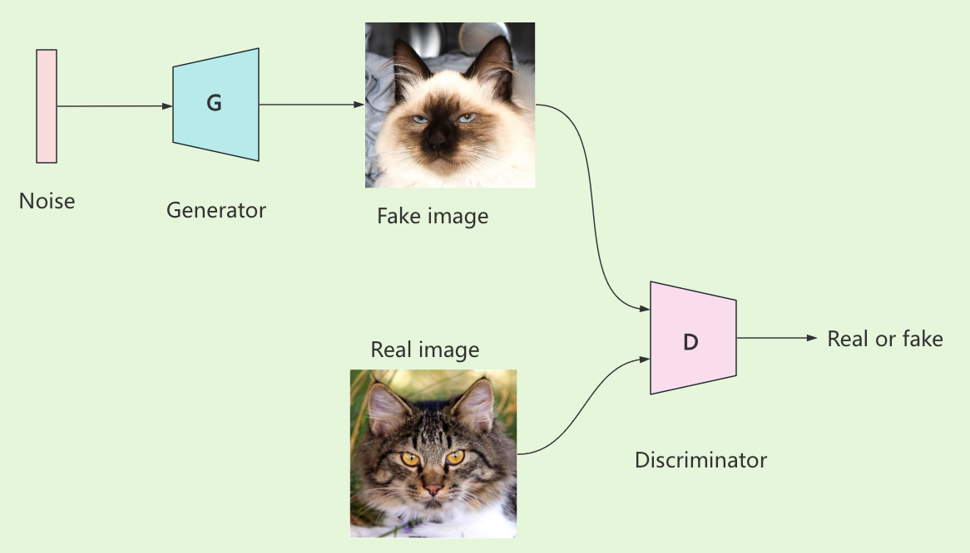
Applying Animal Faces HQ Dataset
19
Dataset Overview:
• Animal Faces-HQ (AFHQ) dataset contains 16,130 high-quality images of animal faces.
• Images are originally 512x512 pixels, downscaled to 128x128 pixels for memory efficiency during training.
Architecture:

Slide 26
Applying Animal Faces HQ Dataset
20
Model Structure:
• The generator takes a 100-dimensional noise vector, has 5 transpose convolutional layers with LeakyReLU activation and batch normalization, and outputs a 3×128×128 image.
• The discriminator takes a 3×128×128 image as input, has 5 convolutional layers with LeakyReLU activation, batch normalization, and dropout and outputs a single probability value indicating real or fake data.
Training Details:
• Optimizer: Adam.
• Learning rate: 0.0002.
• Epochs: 4000 epochs of training using this dataset.

Slide 27
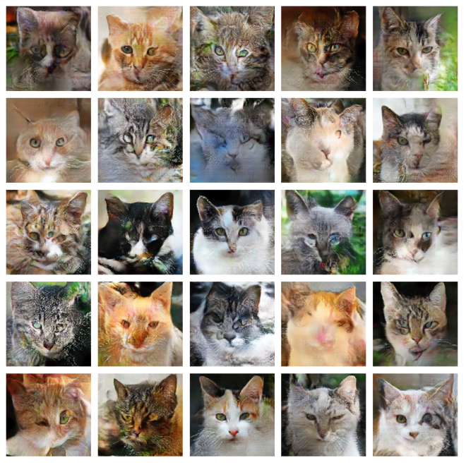
Generate Cat Faces
21

Slide 28
University College Cork
5 Discussion
Kai

Slide 29
Discussion
22
Model Performance:
• The generator demonstrated a capacity to produce relatively high-quality images.
• The discriminator showed effectiveness in distinguishing between real and generated data.
Challenges:
• Data Augmentation: Introduced noise, slightly affecting performance.
• Training Stability: Occasional instability due to adversarial training dynamics.
Evaluation:
FID Scores: Without data augmentation, the model performed more consistently.

Slide 30
Future Work
23
Model Improvements:
• Adjust hyperparameters for better stability.
• Explore advanced architectures like StyleGAN.
• Dataset:
• Use larger and more diverse datasets for improved generalization.
• New Techniques:
• Experiment with adaptive data augmentation methods.

Slide 31


University College Cork
Thank You

